Slide 1

III. Overview: WIPO Arbitration and Mediation Center, Including the 2014 WIPO Rules + ADR Services for Specific Sectors, Including Mediation of Trademark Disputes
Mediation of Trademark Disputes
Tel Aviv
December 11, 2014
Ignacio de Castro, WIPO Arbitration and Mediation Center

Slide 2
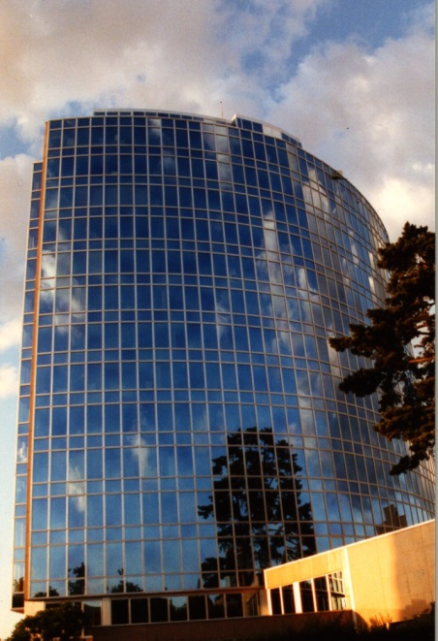

WIPO Arbitration and Mediation Center
Facilitates the resolution of commercial disputes between private parties involving IP and technology, through procedures other than court litigation (alternative dispute resolution: ADR)
    Offices in Geneva (1994) and Singapore (2010)
ADR of IP disputes requires a specialized ADR provider
WIPO neutrals experienced in IP and technology - able to deliver informed results efficiently
Administered over 390 cases of mediation, arbitration and expert determination and over 30,000 internet domain name disputes
International neutrality
Non-profit WIPO fee structure
Commitment to time/cost effective conduct of cases

Slide 3
WIPO ADR
Mediation / Arbitration / Expert Determination
Mediation: an informal consensual procedure in which a neutral intermediary, the mediator, assists the parties in reaching a settlement of their dispute, based on the parties’ respective interests. The mediator cannot impose a decision. The settlement agreement has the force of a contract. Mediation leaves open all other dispute resolution options.
Arbitration: a consensual procedure in which the parties submit their dispute to one or more chosen arbitrators, for a binding and final decision (award) based on the parties’ respective rights and obligations and internationally enforceable as an award under New York Convention. Arbitration constitutes a private alternative to court litigation.
Expert Determination: a consensual procedure in which the parties submit a specific matter (e.g. technical question) to one or more experts who make a determination on the matter, which can be binding unless the parties have agreed otherwise.
Notes:
3

Slide 4
Routes to WIPO ADR
ADR contract clause electing WIPO Rules administered by WIPO Center
  WIPO Rules updated in 2014
Submission agreements for non-contractual disputes
Court referrals
Model clauses: www.wipo.int/amc/en/clauses/index.html
  Parties can shape the process via the clause (e.g., location, language, law, extent of discovery)
  Allows for combination of procedures (e.g., mediation followed by expedited arbitration)

Slide 5
WIPO ADR Options
WIPO Contract Clause/ Submission Agreement
Party Agreement
(Negotiation)
First Step
Mediation
Expert Determination
Expedited Arbitration
Arbitration
Procedure
Determination
Settlement
Award
Outcome

Slide 6
WIPO Model Clause Example: Mediation followed by Expedited Arbitration
"Any dispute, controversy or claim arising under, out of or relating to this contract and any subsequent amendments of this contract, including, without limitation, its formation, validity, binding effect, interpretation, performance, breach or termination, as well as non-contractual claims, shall be submitted to mediation in accordance with the WIPO Mediation Rules. The place of mediation shall be [specify place]. The language to be used in the mediation shall be [specify language]”
If, and to the extent that, any such dispute, controversy or claim has not been settled pursuant to the mediation within [60][90] days of the commencement of the mediation, it shall, upon the filing of a Request for Arbitration by either party, be referred to and finally determined by arbitration in accordance with the WIPO Expedited Arbitration Rules. Alternatively, if, before the expiration of the said period of [60][90] days, either party fails to participate or to continue to participate in the mediation, the dispute, controversy or claim shall, upon the filing of a Request for Arbitration by the other party, be referred to and finally determined by arbitration in accordance with the WIPO Expedited Arbitration Rules. The place of arbitration shall be [specify place]. The language to be used in the arbitral proceedings shall be [specify language]. The dispute, controversy or claim referred to arbitration shall be decided in accordance with [specify jurisdiction] law."
www.wipo.int/amc/en/clauses/index.html
Notes:
6

Slide 7
Why Consider ADR for IP Disputes?
Internationalization of creation/use of IP
  Calls for cross-border solutions; different national laws
Short product and market cycles
  Calls for time-efficient procedures
Collaborative nature of IP creation and commercialization
  Calls for mechanisms that preserve relations
Confidential nature of IP
  Calls for private procedures
Efficient & Flexible
  Need for time- and cost-effective procedures
  Procedures can be structured by parties
Technical & specialized nature of IP
  Calls for the neutral with subject matter expertise
Notes:
7

Slide 8
Why Consider ADR for IP Disputes?
Patent Litigation in Courts
Country | Characteristic of Legal System | Average Length | Average Costs
France | - Civil Law - Unified Litigation - No specialized courts | First Instance: 12-24months Appeal: 18-24 months | € 80,000-150,000 (1st Inst.)
Germany | - Civil Law - Bifurcated Litigation - Specialized courts | First Instance: 12 months Appeal: 15-18 months | € 50,000 (1st Inst.) € 70,000 (App.)
Spain | Civil Law - Unified Litigation - Commercial courts | First Instance: 12 months Appeal: 12-24 months | € 100,000 (1st Inst.) € 50,000 (App.)
UK | Common Law - Unified Litigation - Specialized courts - Mediation promoted | First Instance: 12 months Court of Appeal: 12 months Supreme Court: 24 months | € 550,000-1,500,000 (1st Inst.) € 150,000-1,500,000 (App.) € 150,000-1,500,000 (Supreme Court)
China | - Civil Law - Bifurcated Litigation - Specialized courts | First Instance: 6 months Appeal: 3 months | USD 150,000 (1st Inst.) USD 50,000 (App.)
Japan | - Civil Law - Bifurcated Litigation - Specialized courts | First Instance: 14 months Appeal: 9 months | USD 300,000 (1st Inst.) USD 100,000 (App.)
USA | - Common Law - Unified Litigation Specialized court of appeals (CAFC) Jury trial available Mediation promoted | First Instance: up to 24 months Appeal: 12+ months | USD 650,000-5,000,000* (1st Inst.) USD 150,000-250,000 (App.)
This chart is based on figures provided in Patent Litigation - Jurisdictional Comparisons, Thierry Calame, Massimo Sterpi (ed.), The European Lawyer Ltd, London 2006.
* Report of the Economic Survey, Prepared Under the Direction of Law Practice Management Committee, AIPLA, Arlington 2011.
Notes:
8

Slide 9
Further Considerations about IP ADR
Contractual basis
  No obligation to submit to ADR procedure without contract clause
  Difficult to agree on clause once dispute has arisen
  Unsuitable for bad-faith infringement (e.g. counterfeiting)
Parties must pay fees of neutrals
  Crucial importance of getting value for money
  ADR efficiency and results can make for substantial benefits
Arbitration award binding only between the parties
  inter partes effect sufficient

Slide 10
Areas of WIPO Cases
Contractual: patent licenses, software/IT, R&D and technology transfer agreements, patent pools, distribution agreements, joint ventures, copyright collecting societies, trademark coexistence agreements, settlement agreements, as well as general commercial issues
Non-contractual: infringement of IP rights
Domestic and international disputes (25/75%)
Amount in dispute from USD 50,000 to USD 1 billion
WIPO case examples
  www.wipo.int/amc/en/mediation/case-example.html
  www.wipo.int/amc/en/arbitration/case-example.html

Slide 11
WIPO Cases: Types of Procedures

Slide 12
Settlement in WIPO-Administered Cases

Slide 13
Areas of WIPO Cases

Slide 14
WIPO 2013 International Survey on Dispute Resolution in Technology Transactions
http://www.wipo.int/amc/en/center/survey/results.html
Place of Survey Respondent Business Operations
Type of Survey Respondent
Notes:
Question 7

Slide 15
WIPO 2013 International Survey on Dispute Resolution in Technology Transactions
Scope of Agreements: Parties/Technology
  91% of respondents conclude agreements with parties from other jurisdictions.
  80% of respondents conclude agreements relating to technology patented in multiple jurisdictions.
WIPO Center Report on International Survey of Dispute Resolution
in Technology Transactions (2013)
www.wipo.int/amc/en/center/survey/results.html
Notes:
This also corresponds to the WIPO case experience where 71% of WIPO mediation and arbitration cases administered have been international in scope and of patent-related WIPO arbitrations and mediations, 92% have been international in scope.

Slide 16
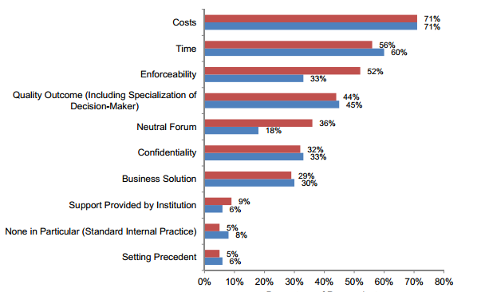
Top Ten Considerations in Choice of Dispute Resolution Clause in International Contracts
WIPO Center Report on International Survey of Dispute Resolution
in Technology Transactions (2013)
www.wipo.int/amc/en/center/survey/results.html

Slide 17
Relative Costs of Dispute Resolution Options
Court litigation of IP disputes in foreign jurisdiction
  Average of 3.5 years
  Cost slightly over USD 850,000
Arbitration
  Average just over 1 year
  Average cost USD 400,000 (WIPO cases, USD 165,000)
Expedited Arbitration
  Average 9 months (WIPO cases, 7 months)
  Average cost under USD 50,000
Mediation
  Average of 8 months (WIPO cases, 5 months)
  91% of Respondents stated costs typically under USD 100,000
  (WIPO cases USD 21,000)
WIPO Center Report on International Survey of Dispute Resolution in Technology Transactions (2013)
www.wipo.int/amc/en/center/survey/results.html

Slide 18
WIPO Tailored ADR for Specific Sectors
  National Intellectual Property Offices (incl. IPOS Singapore, INPI Brazil, IPOPHL Philippines, IMPI Mexico)
    Information and Communication Technology
  Research & Development/Technology Transfer (incl. DESCA)
  Art and Cultural Heritage (inc. ICOM)
  Film and Media and Entertainment (incl. FRAPA)
  Patents in Standards (for FRAND disputes)
  Internet Domain Name Disputes

Slide 19
WIPO – IPOS Collaboration
In September 2011, MOU with Intellectual Property Office of Singapore (IPOS)
  Establishment of joint procedures to facilitate resolution of IP disputes pending before IPOS
WIPO Mediation for Pending Trademark Proceedings
  Areas: trademark opposition, invalidation, revocation, etc.
  WIPO Administration of Disputes
  WIPO Panel of (Singapore-based) Mediators
  Reduced, Flexible Fees and Costs

Slide 20
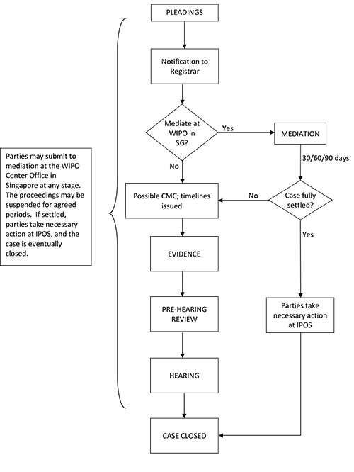
WIPO Mediation Option for Trademark Disputes Pending before IPOS

Slide 21
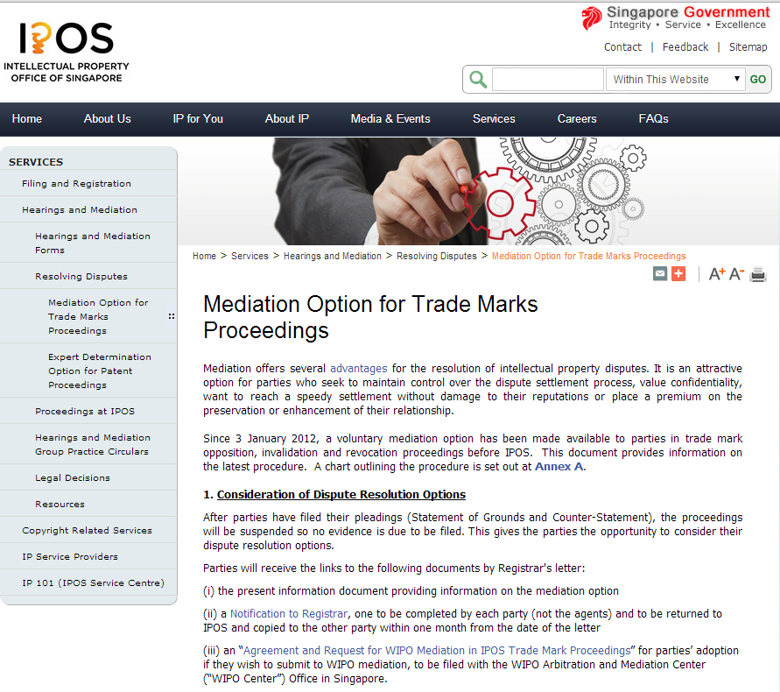

Slide 22
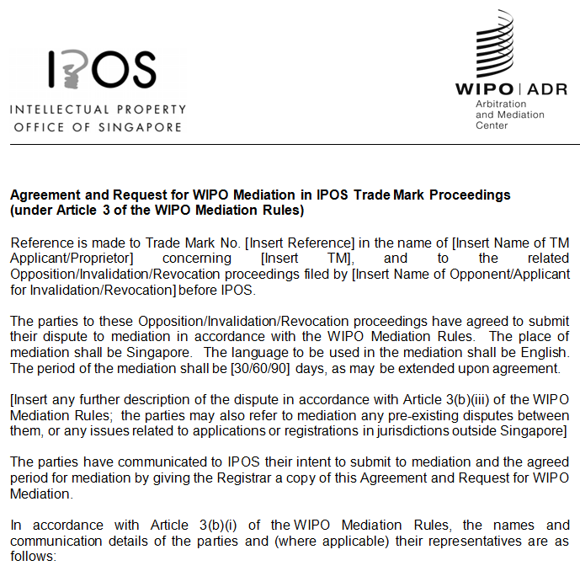

Slide 23
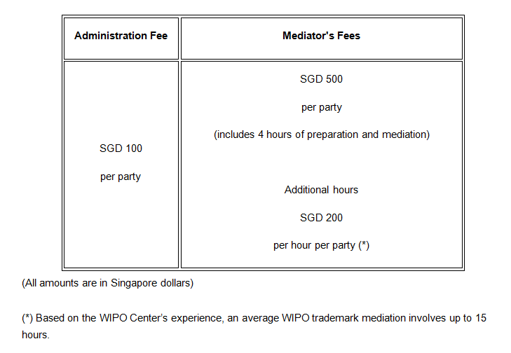
WIPO – IPOS Collaboration

Slide 24
WIPO Mediation Example
Three TM applications filed with IPOS by applicants based in Singapore, Malaysia and Indonesia (and two TM opposition procedures in Malaysia)
Opponent based in Singapore
Parties agreed to refer the dispute to WIPO Mediation, place of mediation Singapore
WIPO Center provided list of candidates
Parties and mediator met for one day
Settlement agreement: opponent commits to withdraw and terminate all opposition procedures and undertakes not to oppose or challenge applicants’ TM
Total time: 4 months

Slide 25
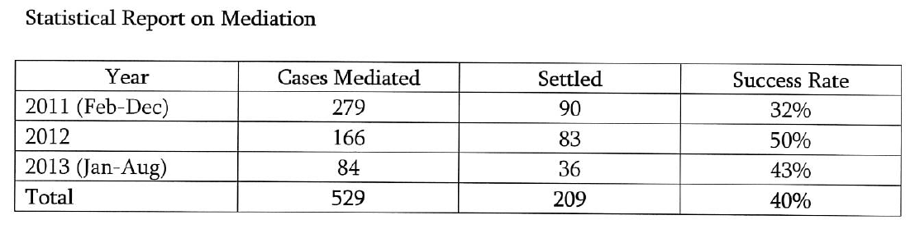
IPOPHL (Philippines) Mediation
Mandatory mediation for IP disputes (incl. trademark oppositions)
Competitive fees

Slide 26
Additional Information
WIPO Rules, procedures, neutrals and case examples: http://www.wipo.int/amc/en/
WIPO model clauses: http://www.wipo.int/amc/en/clauses/
Contact information:
  General queries and case filing: arbiter.mail@wipo.int
Thank you

